Slide 1
Automated Blinds with Arduino
Rosen Stratkov

Slide 2
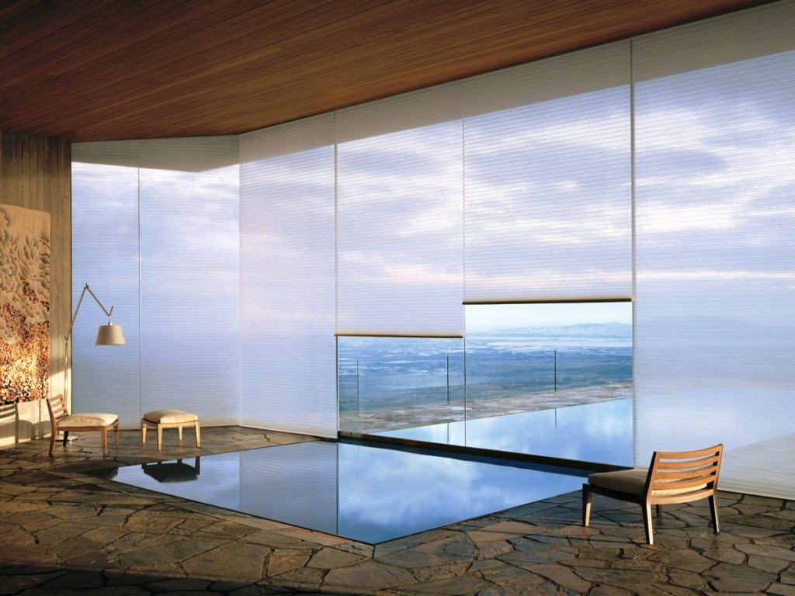
Inspiration
Useful
Interesting

Slide 3

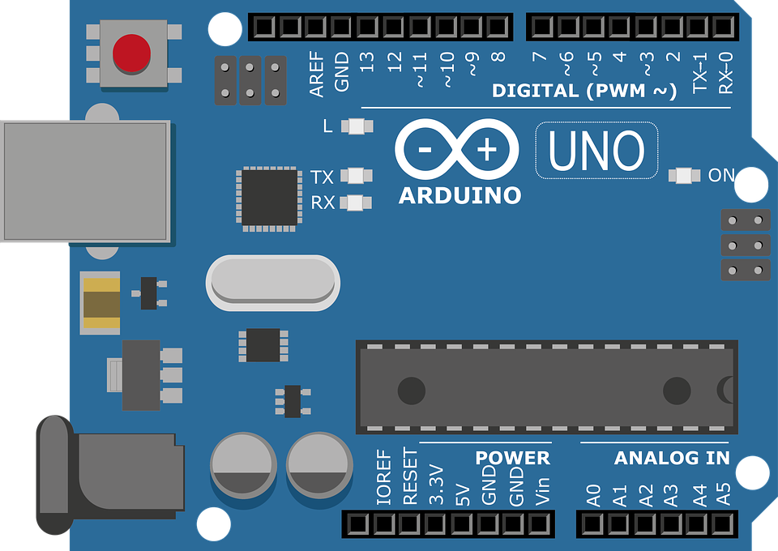



Why automated blinds?

Slide 4
Process of Development
Things that worked
Things that first worked but then stopped working

Slide 5
How does it work?
Light sensors
Android application
Buttons

Slide 6
How does it work?
Stepper motor
ESP8266

Slide 7
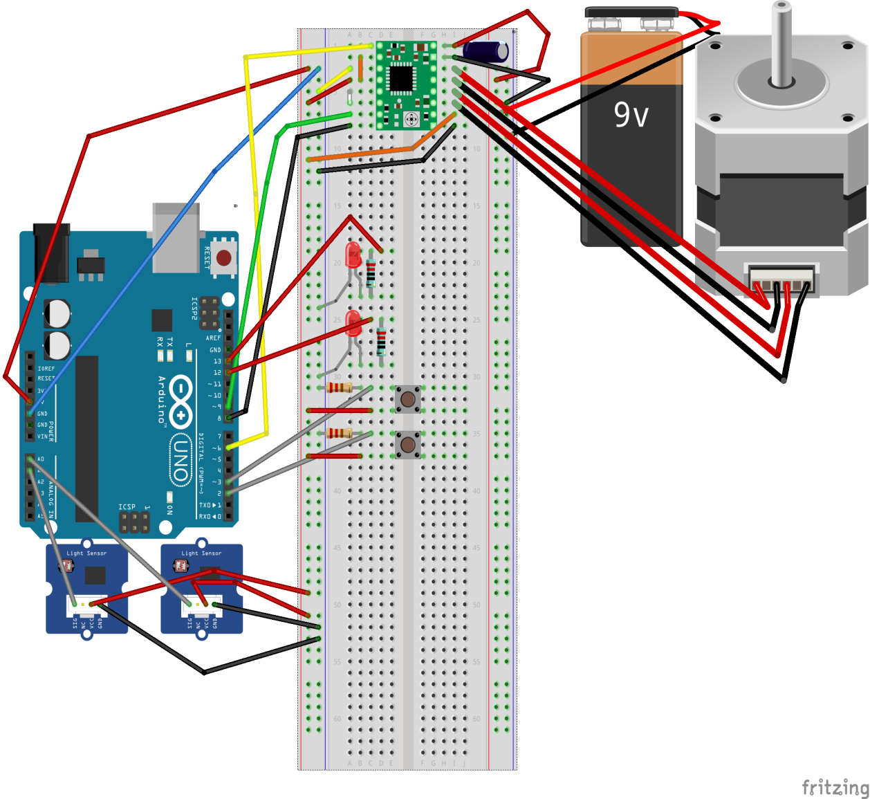
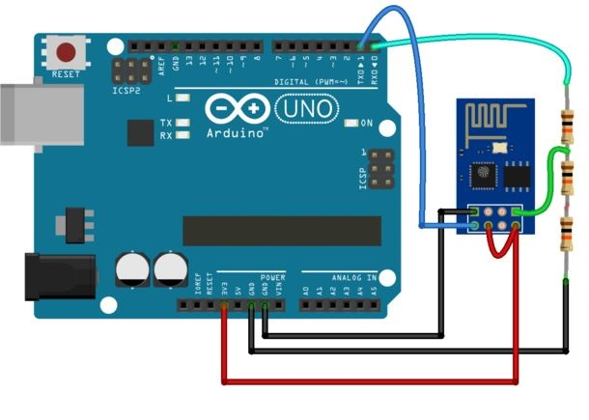
Schematics

Slide 8
Thank you for your attention

